Slide 1
Introduction to ESIPAP Computing Sessions
Wednesday 8 – Thursday 9 February 2023
ERIC CHABERT - ERIC CONTE

Slide 2
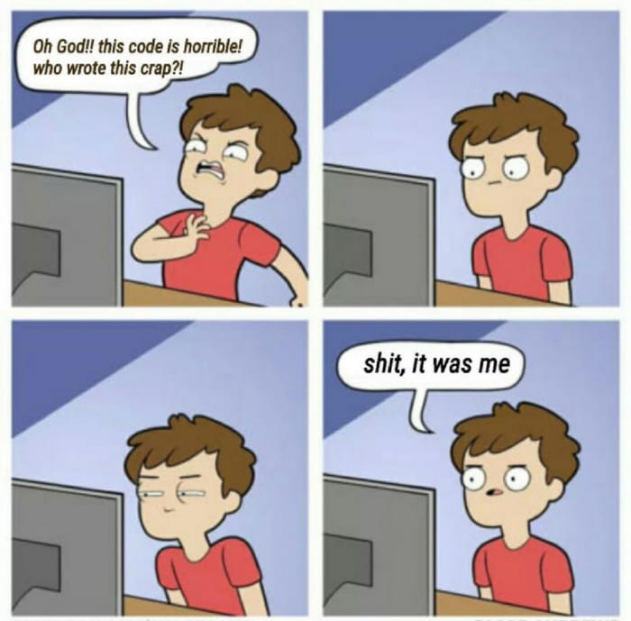
Goals of the computing sessions
Computing is required for instrumentation purposes:
Simulation of sensor
Data acquisition
Data analysis
Algorithm and reconstruction of physics objects
Computing sessions target to apply your theoretical knowledge:
Instrumentation
Software programming in C++
Using specific tools of high energy physics: ROOT
Working by yourself and experimenting
Getting the good practice

Slide 3
Physics Context

Slide 4
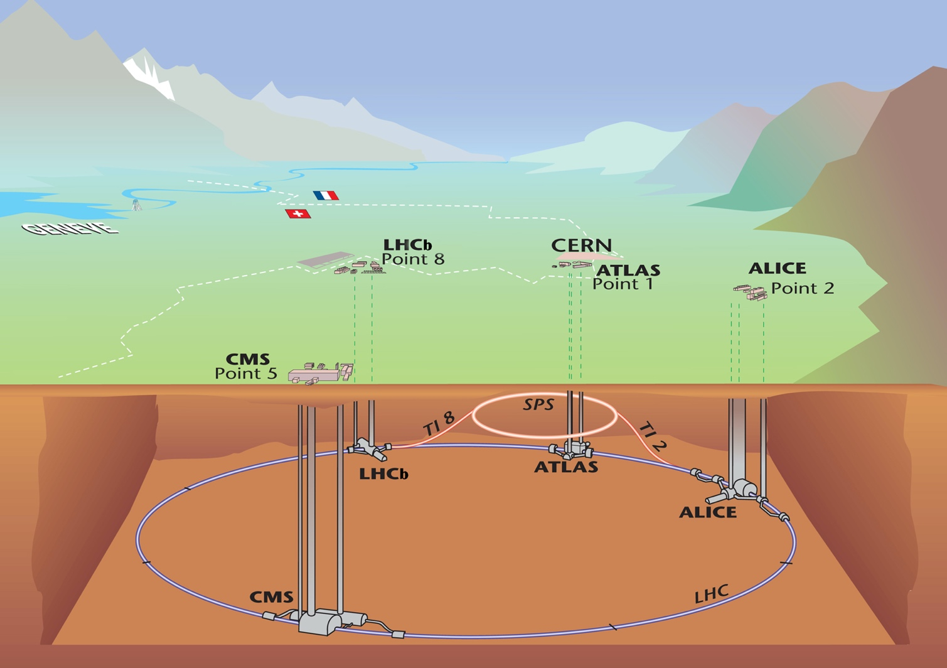
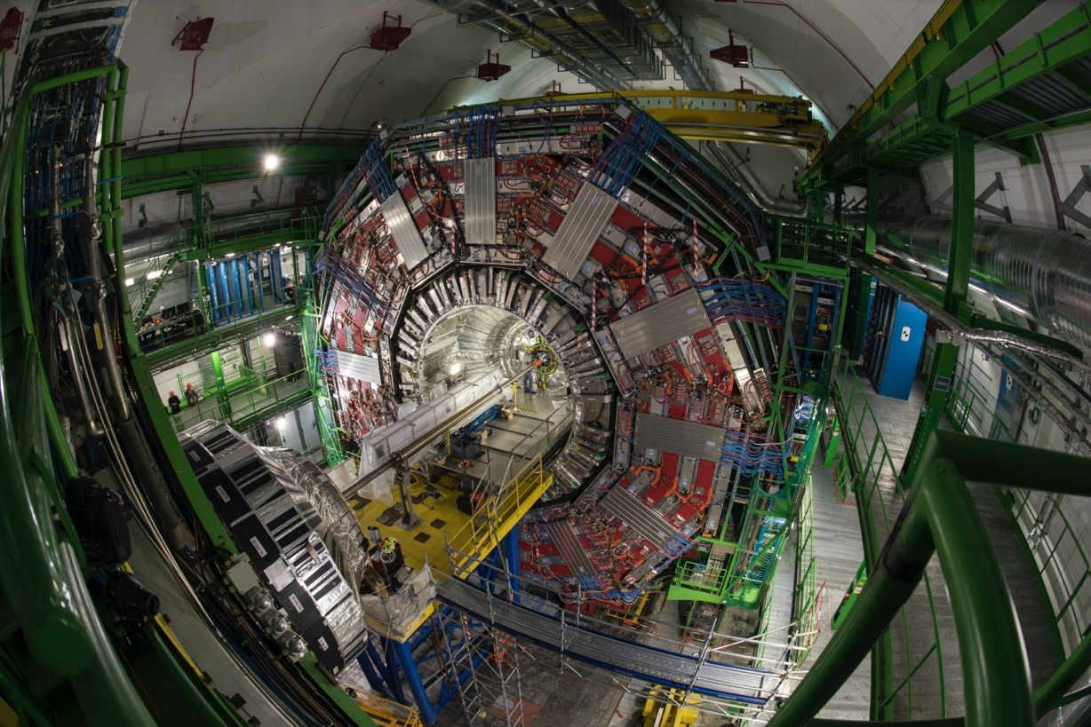
The CMS (Compact Muon solenoid) detector

Slide 5
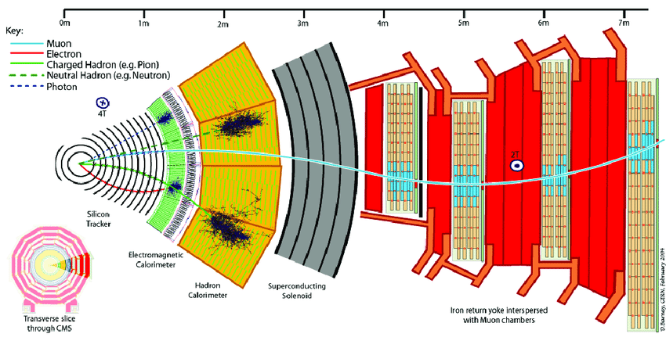
The CMS (Compact Muon solenoid) detector

Slide 6
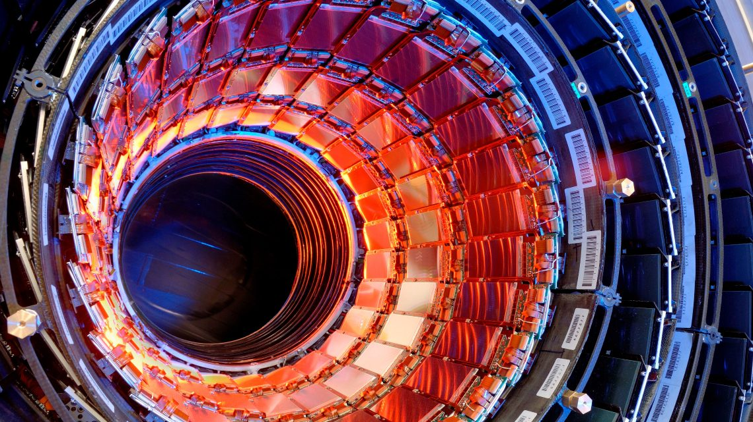
Silicon strip tracker

Slide 7
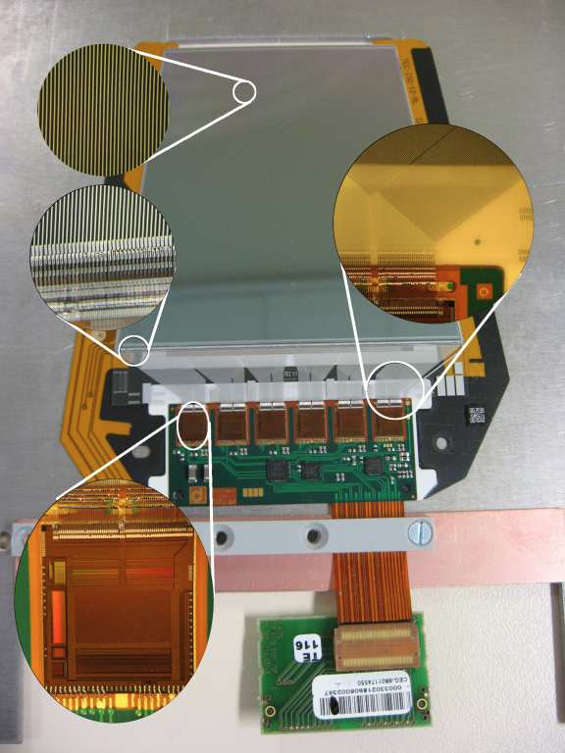
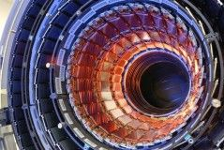
Silicon strip tracker
CMS silicon strip tracker in few numbers:
15 000 modules
Surface: ~ 200 m²
10⁶ channels
Instrumental activities
R&D
Construction
Operation (online)
Alignment & calibration
Offline analyses
Simulation
Radiation damages evaluation
…
Performances:
Hit resolution: 20-40 μm
Hit efficiency > 98% (at high Pile-Up)
Timing alignment accuracy: 1ns
…

Slide 8
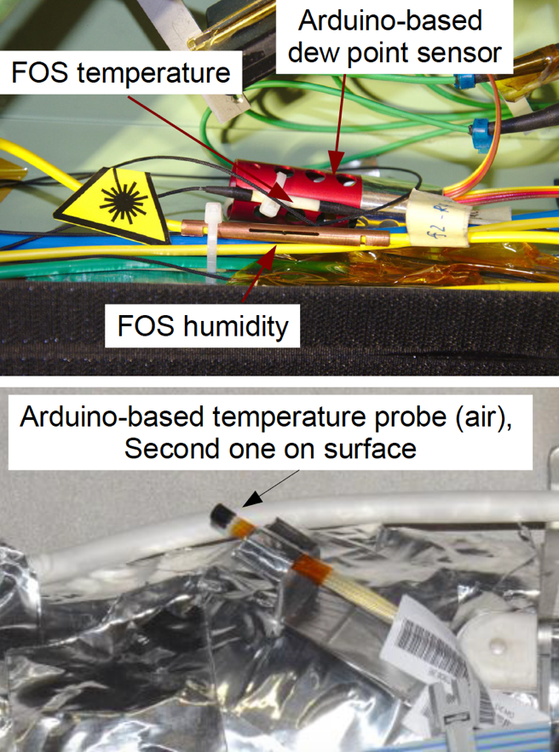
Silicon strip tracker
During its operation it is important to monitor environment conditions:
Temperature
Leakage current
Noise
Thermal dissipation
Radiation damages
…
Humidity
Dew points & condensation
Front End electronics
…
Monitoring tools
Several probes are used to monitor that:
On-board sensors
External sensors
Some are Arduino-based!

Slide 9
Computing session aims
Slow control
Using a dedicated electronic board (Sense Hat) read by a Raspberry
Monitor the temperature & humidity
Send warning when conditions are not fulfilled
Offline analyses
Calibration of the temperature sensors
Evaluation of the sensor resolution
3. Simulation
Basic simulation with the Geant4 package of a CMS silicon strip sensor
Instrumental activities
R&D
Construction
Operation (online)
Alignment & calibration
Offline analyses
Simulation
Radiation damages evaluation
…

Slide 10
SETUP

Slide 11
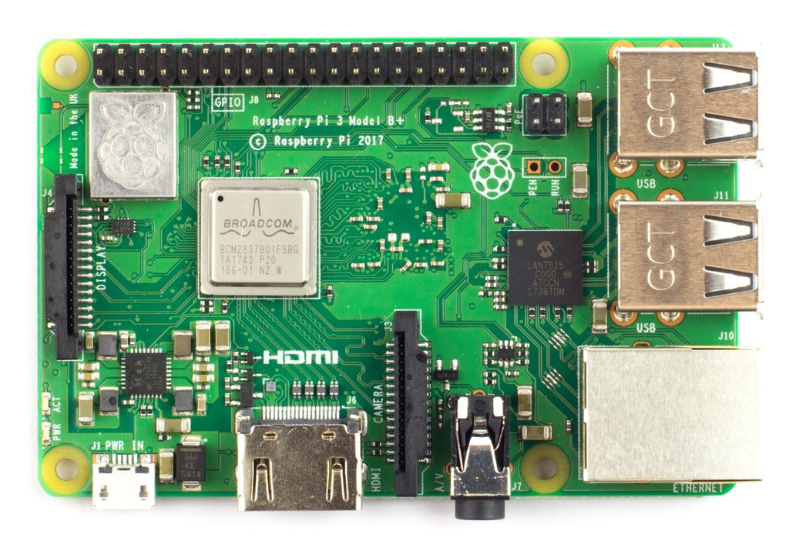
The Raspberry board
Raspberry Pi 3 B+ motherboard
Quad-core 64 bits processors @ 1,4 GHz
ARM (Acorn Risc Machine) architecture used mainly in smartphones, tablets, robotics, automation Advantages : price, flexibility, performances

Slide 12
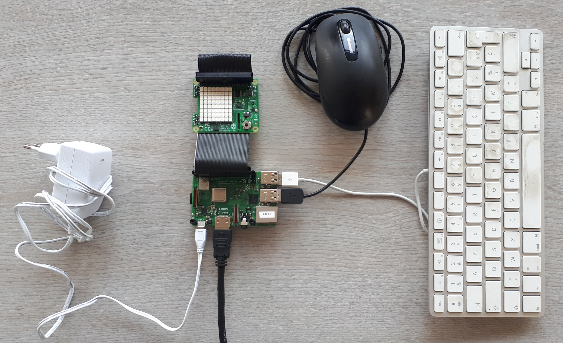
Connections to peripherical devices
4 USB ports
1 ethernet port
1 HDMI plug
1 GPIO (General Purpose Input/Output) port for connecting sensors
Powered by micro USB (5V, 2.5A min)
+ WIFI
+ Bluetooth

Slide 13
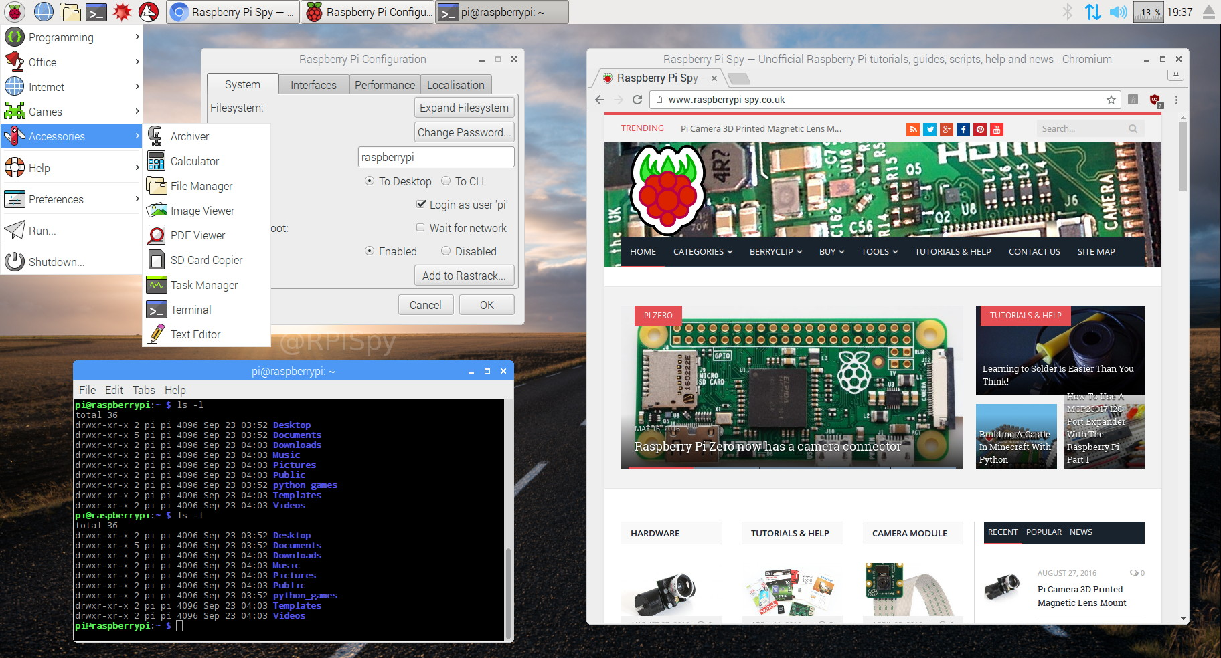
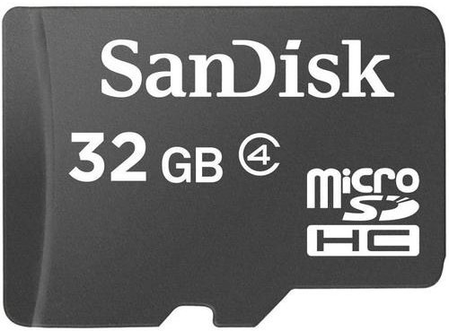
Linux distribution: Raspbian
Stored on a micro SD card

Slide 14
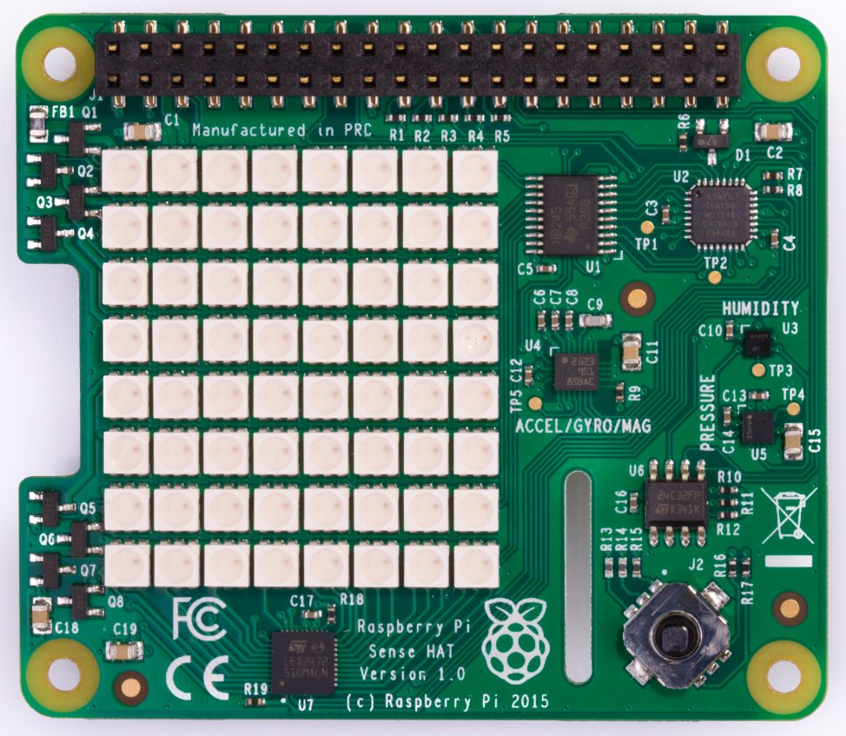
Sense Hat board
3D accelerometer, 3D gyrometer and 3D magnetometer sensor
8x8 LEDs for display
Humidity / Temperature
sensor
Pressure / Temperature
sensor
Joystick

Slide 15
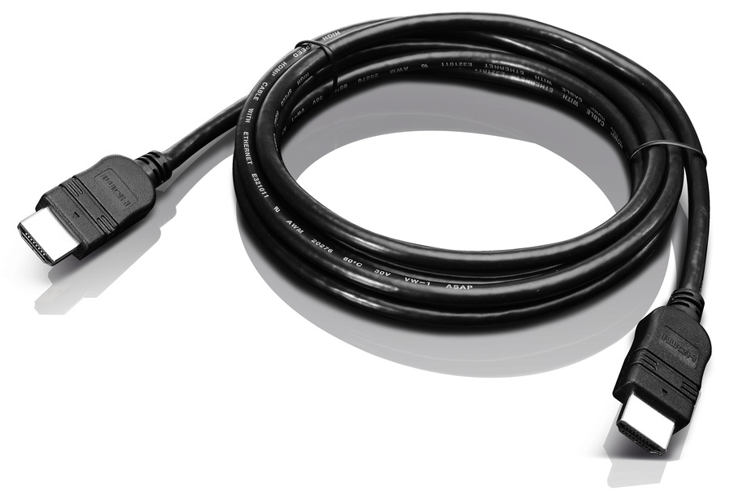
Price
Raspberry Pi 3 B+
~ 40 €
Sense Hat
~ 30 €
Total: ~ 100€
(good gift for Saint-Valentin’s day)
Connectors
~ 15 €
Micro SD
~ 10 €

Slide 16
SETUP

Slide 17
The Raspberry board
Raspberry Pi 3 B+ motherboard
Quad-core 64 bits processors @ 1,4 GHz
ARM (Acorn Risc Machine) architecture used mainly in smartphones, tablets, robotics, automation Advantages : price, flexibility, performances

Slide 18
Connections to peripherical devices
4 USB ports
1 ethernet port
1 HDMI plug
1 GPIO (General Purpose Input/Output) port for connecting sensors
Powered by micro USB (5V, 2.5A min)
+ WIFI
+ Bluetooth

Slide 19
Linux distribution: Raspbian
Stored on a micro SD card

Slide 20
Sense Hat board
3D accelerometer, 3D gyrometer and 3D magnetometer sensor
8x8 LEDs for display
Humidity / Temperature
sensor
Pressure / Temperature
sensor
Joystick

Slide 21
Price
Raspberry Pi 3 B+
~ 40 €
Sense Hat
~ 30 €
Total: ~ 100€
(good gift for Saint-Valentin’s day)
Connectors
~ 15 €
Micro SD
~ 10 €

Slide 22
DATA USED IN THE COMPUTING SESSIONS

Slide 23
Organization

Slide 24
Organization in sessions
9:00
12:15
14:00
17:15
Session 1
Session 2
Wednesday
Introduction
Data acquisition
Developing a C++ class
Session 3
Session 4
Thursday
Combining classes
Analyzing data with ROOT

Slide 25


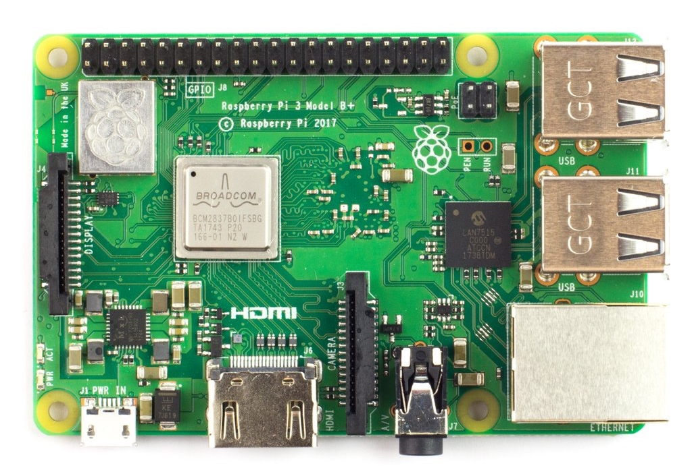


Multi-plaTform development
Windows
Linux
Mac OS X
Raspberry board (ARM architecture)

Slide 26





Tools to USE
Saving and preserving code on the internet: site github
Sharing codes with others.
Generating automatically documentation of your code (in HTML and LaTex)
Building a C++ project witch several files
(Linux / MacOSX only)

Slide 27
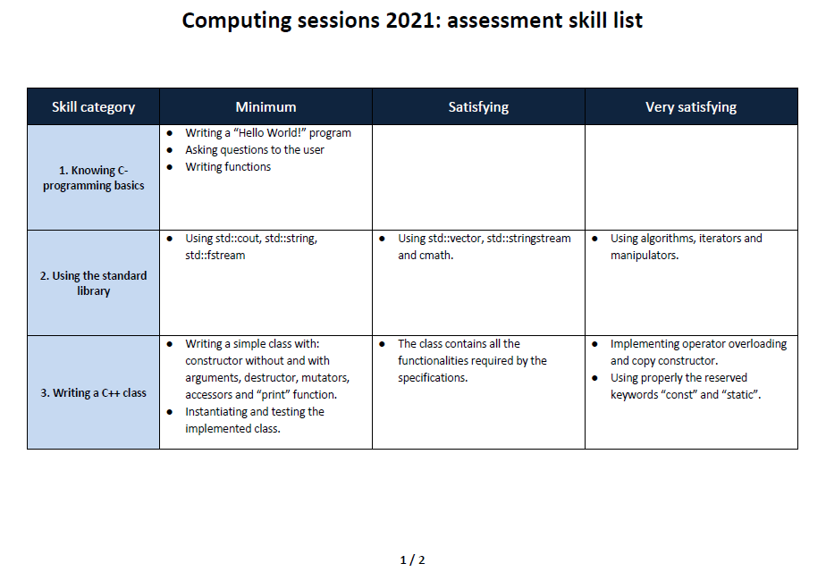
Skill assessment
Individual work is required
Evaluation over 8 categories
For validating the module
Minimum level must be reached for all the 8 categories
Satisfying level for at least 4 categories

